Slide 1



Report of the meeting with the monitoring committee
LE Van Linh
Talence, 18 July 2017

Slide 2
Subject
Supervisor: Marie BEURTON-AIMAR
“Extraction automatique de caractéristiques morphologiques des espèces pour la classification d'insectes: application aux ravageurs de culture et espèces invasives”

Slide 3
Motivation
How to characterize the information at the macro level of animal?
  Directly on the body: width, length, landmarks,...
  Automatically via the pictures with image processing techniques: contours, histogram analysis, point of interest,...
Landmark
  A kind of points of interest
  Defined by biologist
  For examples: the tip of mandible, the intersection of the tendons on the wing,...
Notes:
Classification is an

Slide 4
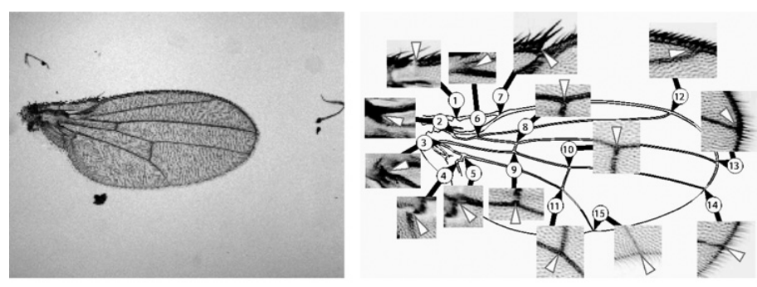
State of the arts
Automatic extraction the landmarks on wing morphometry^{1,2}
1. Palaniswamy, Sasirekha, Neil A. Thacker, and Christian Peter Klingenberg. “Automatic identification of landmarks in digital images.” IET Computer Vision 4.4 (2010): 247-260.
2. J Goczał, R Rossa, J Sweeney, and A Tofilski. “Citizen monitoring of invasive species : wing morphometry as a tool for detection of alien tetropium species”. Journal of Applied Entomology, 2016
(*) The images are extracted from [1]

Slide 5
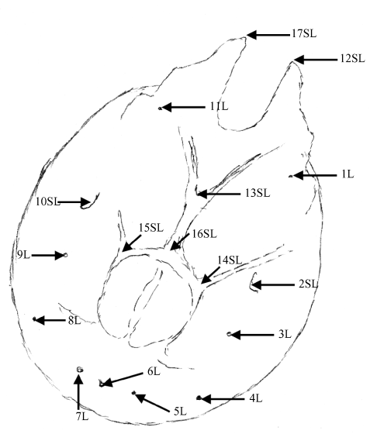
State of the arts
Analysis the cephalometry in human orthodontics^{1,2}
1. Md Mesbahul Hoque, Shamim Ara, Shahanaz Begum, AHM Mostafa Kamal, and Sharmina Sayeed. “Morphometric analysis of dry adult human mandibular ramus”. Bangladesh Journal of Anatomy, 12(1) :14–16, 2015
2. José Maria Becerra and Antonio G Valdecasas. “Landmark superimposition for taxonomic identification”. Biological Journal of the Linnean Society,, 81:page 267–274, 2004
(*) The image is extracted from [2]

Slide 6
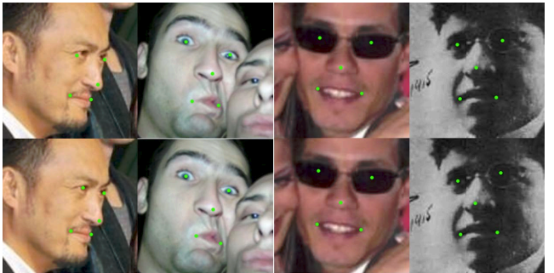
State of the arts
Facial point detection^{1,2}
1. M. Dantone, J. Gall, G. Fanelli, and L. J. V. Gool. “Real-time facial feature detection using conditional regression forests”. In Proc. CVPR, 2012
2. Sun, Y., Wang, X., Tang, X.: “Deep convolutional network cascade for facial point detection”. In: CVPR, pp. 3476–3483 (2013)
(*) The images are extracted from [2]

Slide 7
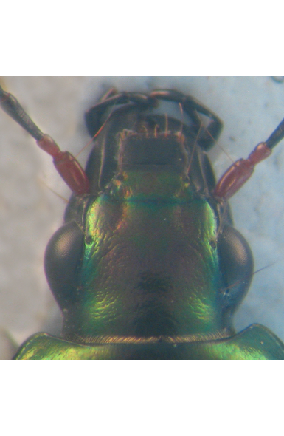
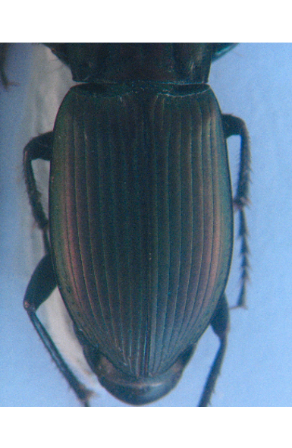
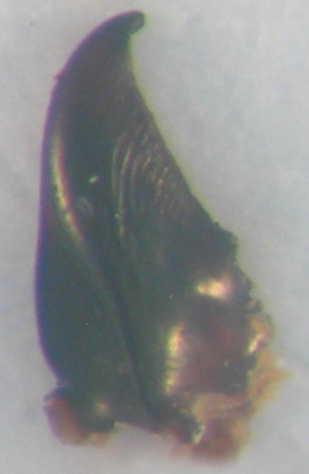
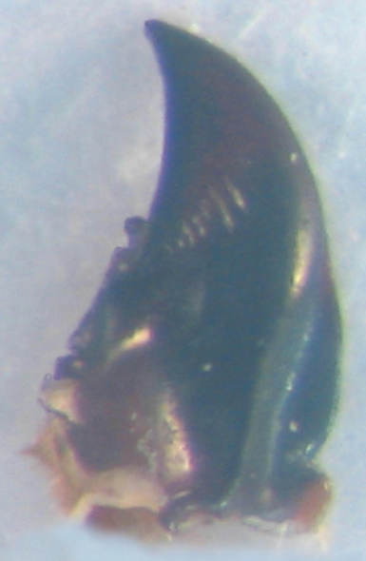
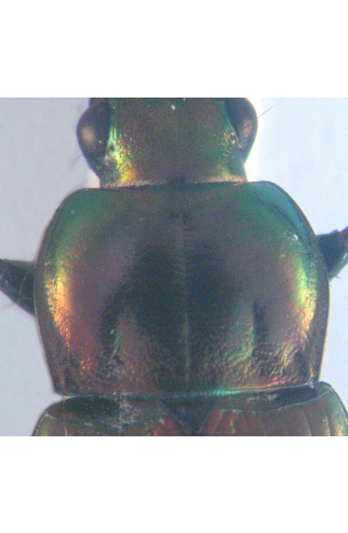
Objective of the thesis
Dataset
  Color images (2D) of 293 insects (beetles)
  Five images by animal: head, pronotum, wing, left and right mandibles.

Slide 8
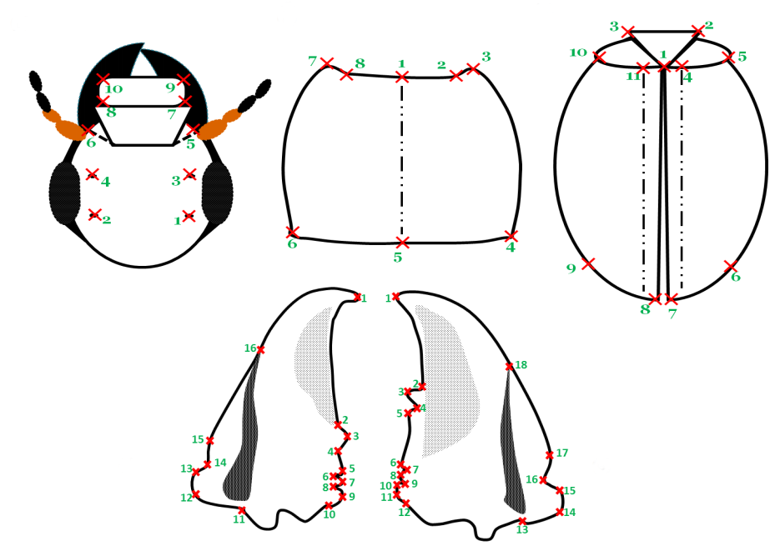
Objective of the thesis
How to estimate automatically these landmarks?

Slide 9
Status of the thesis
Focus on left and right mandibles

Slide 10
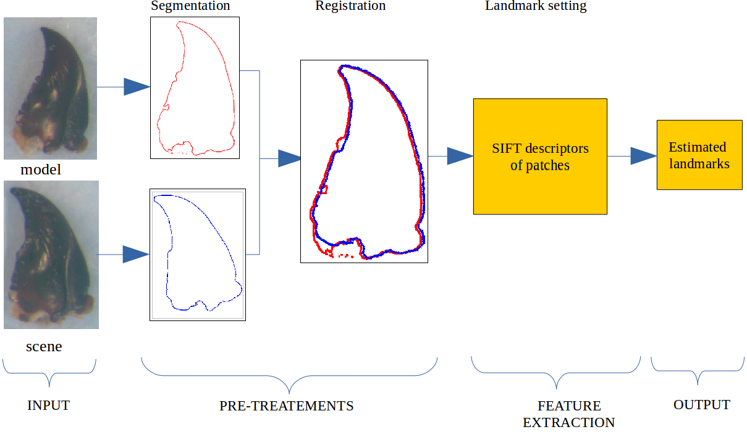
Status of the thesis

Slide 11
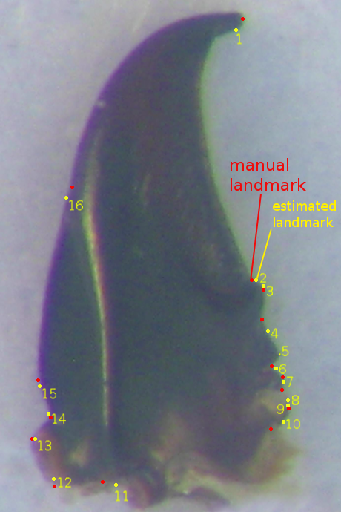
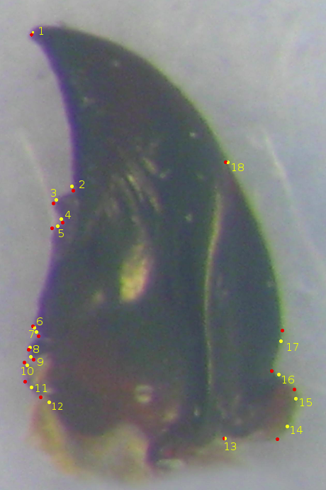
Status of the thesis

Slide 12
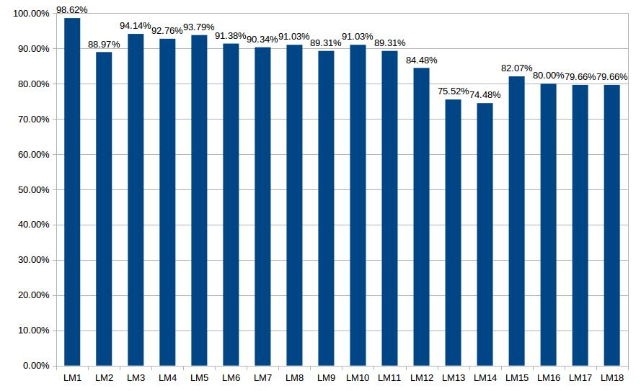
Status of the thesis

Slide 13
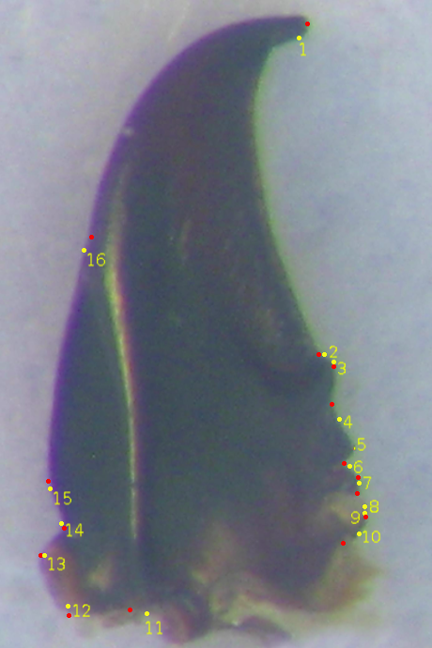
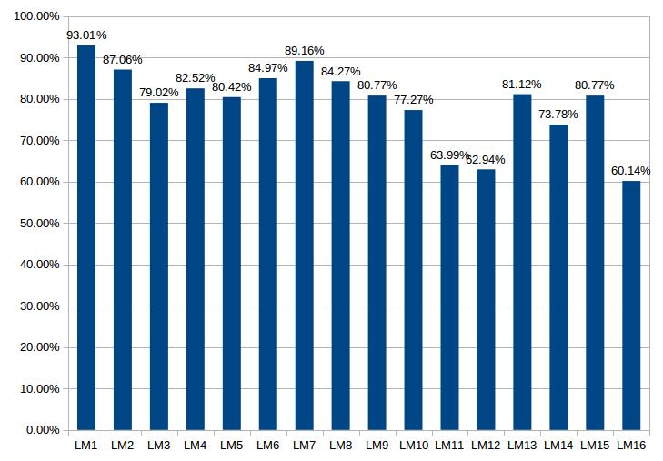
Status of the thesis

Slide 14
Future works
Deep learning
Texture localization techniques

Slide 15
Training courses attended
M1 Informatique S8 (4TIS801S): Traitement d'Image
Online courses:
  Module 1 – Les enjeux de l'intégrite scientifique
  Module 2 – Les manquements à l'intégrité scientifique: c'est quoi? Pourquoi?
  Module 3 – Prevenir les inconduites: quelques règles de base
  Module 4 – La régulation de l'intégrité scientifique

Slide 16
Thank you

